Slide 2
OTTAWA EMC Chapter

Slide 3
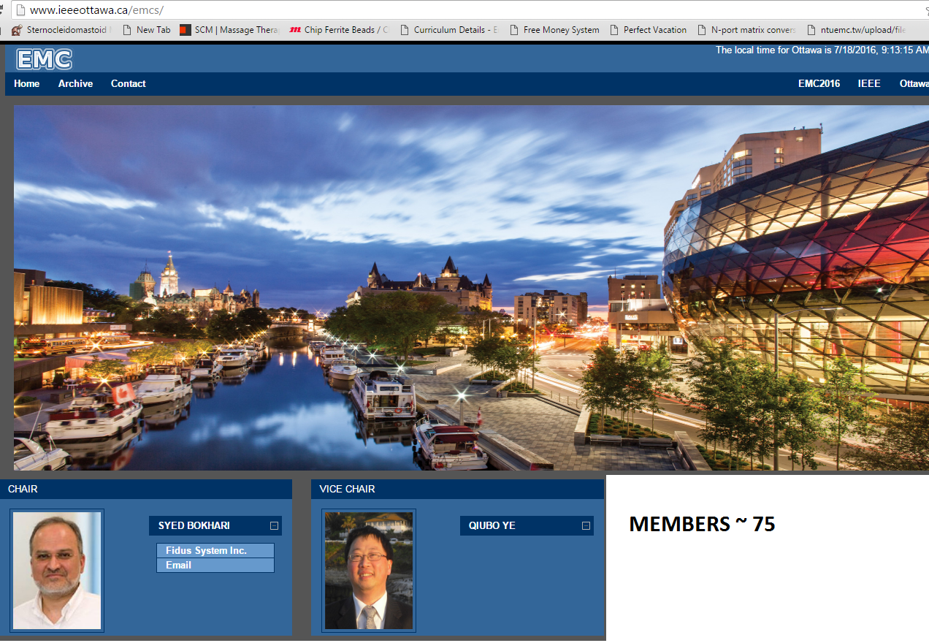

Slide 4
Chapter has remained individual, although most presentations are co-sponsored by the Ottawa IEEE MTT/AP chapter and the CPMT chapter
FIDUS SYSTEMS- Main Industry sponsor
Holds 3 or more DL and technical presentations annually
Notable achievement: 2016 EMC Symposium

